Slide 1





TCBDA 14
Project Churn
Rotem Singer
ID: 301805065
Python
pandas matplotlib
numpy sci-kit learn

Slide 2
What are we trying to predict?
We are trying to predict if a customer in out system will be churned or not.
We will try to estimate which columns are significant in deciding if a customer will be churned or not.
We will try to find underlying dependencies between the “feature” columns and the “label” columns

Slide 3
The input (The available data)
A .csv file which includes:
A “label” column - “churn” - which represents if a customer was churned or not (1/0)
“Feature” columns - all other columns in the file which could decide if a customer was churned or not.
The “customerID” column which should not be regarded as a feature because it is only a string representation of a customer and has no other meaning.

Slide 4
Motivations and applications
Have the ability to make good predictions which will help the company improve and prevent as many churned customers as possible.
Gaining knowledge about the customers which can’t be concluded by simply looking at SQL tables
Creating models that are trained and tested all the time in order to adjust to different types of customers across many years

Slide 5
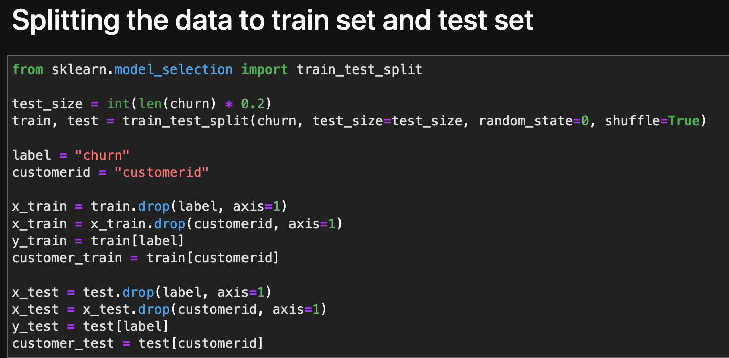
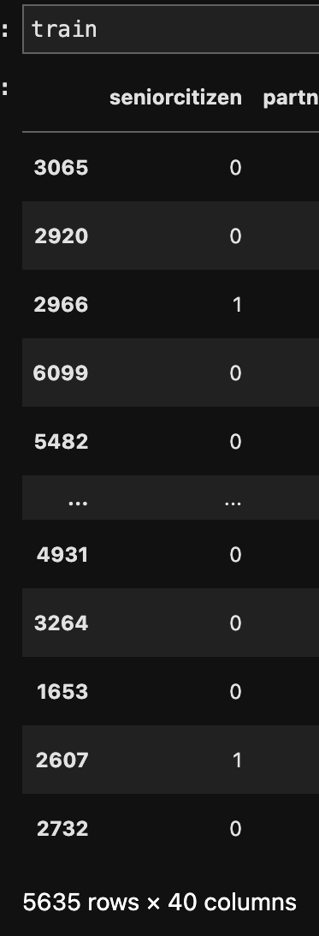
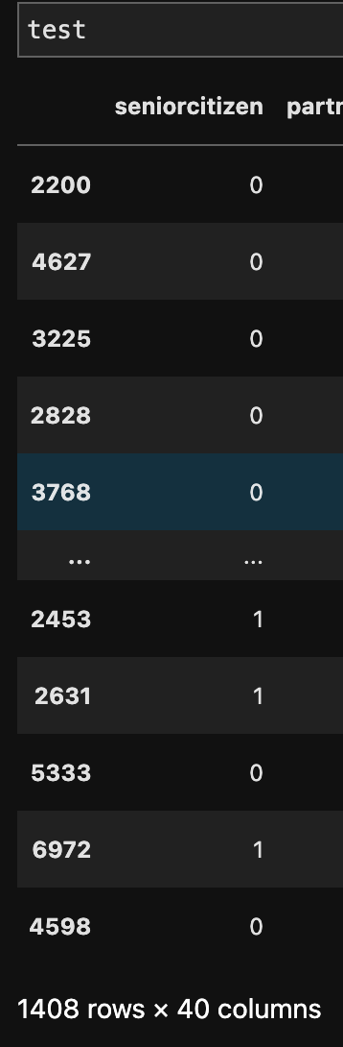
The training set and the test set
The entire dataset has 7043 rows
Therefore, the dataset will be split by a ~80% training set and ~20% test set ratio.
It is calculated as 5635 rows of the training set and 1408 of the test set

Slide 6
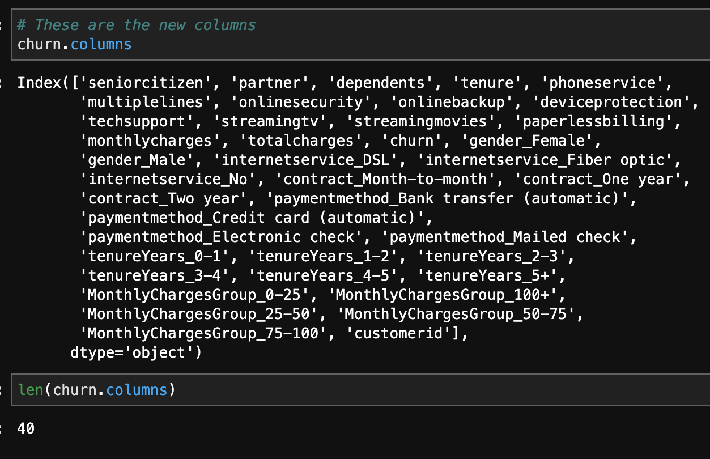
The features of the dataset
After performing the feature engineering and “one hot encoding” we ended up with 40 columns

Slide 7
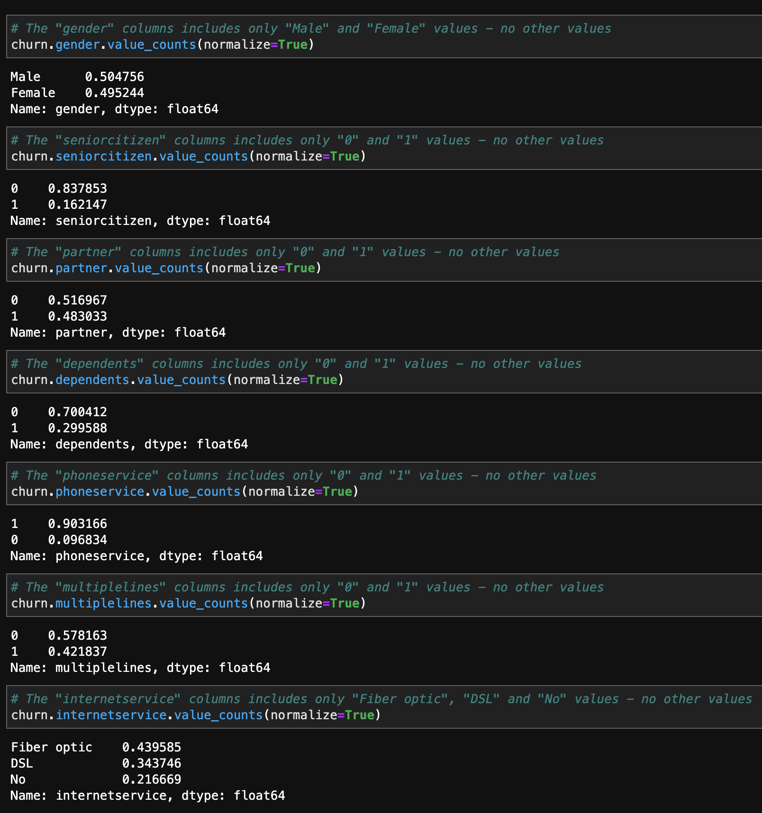
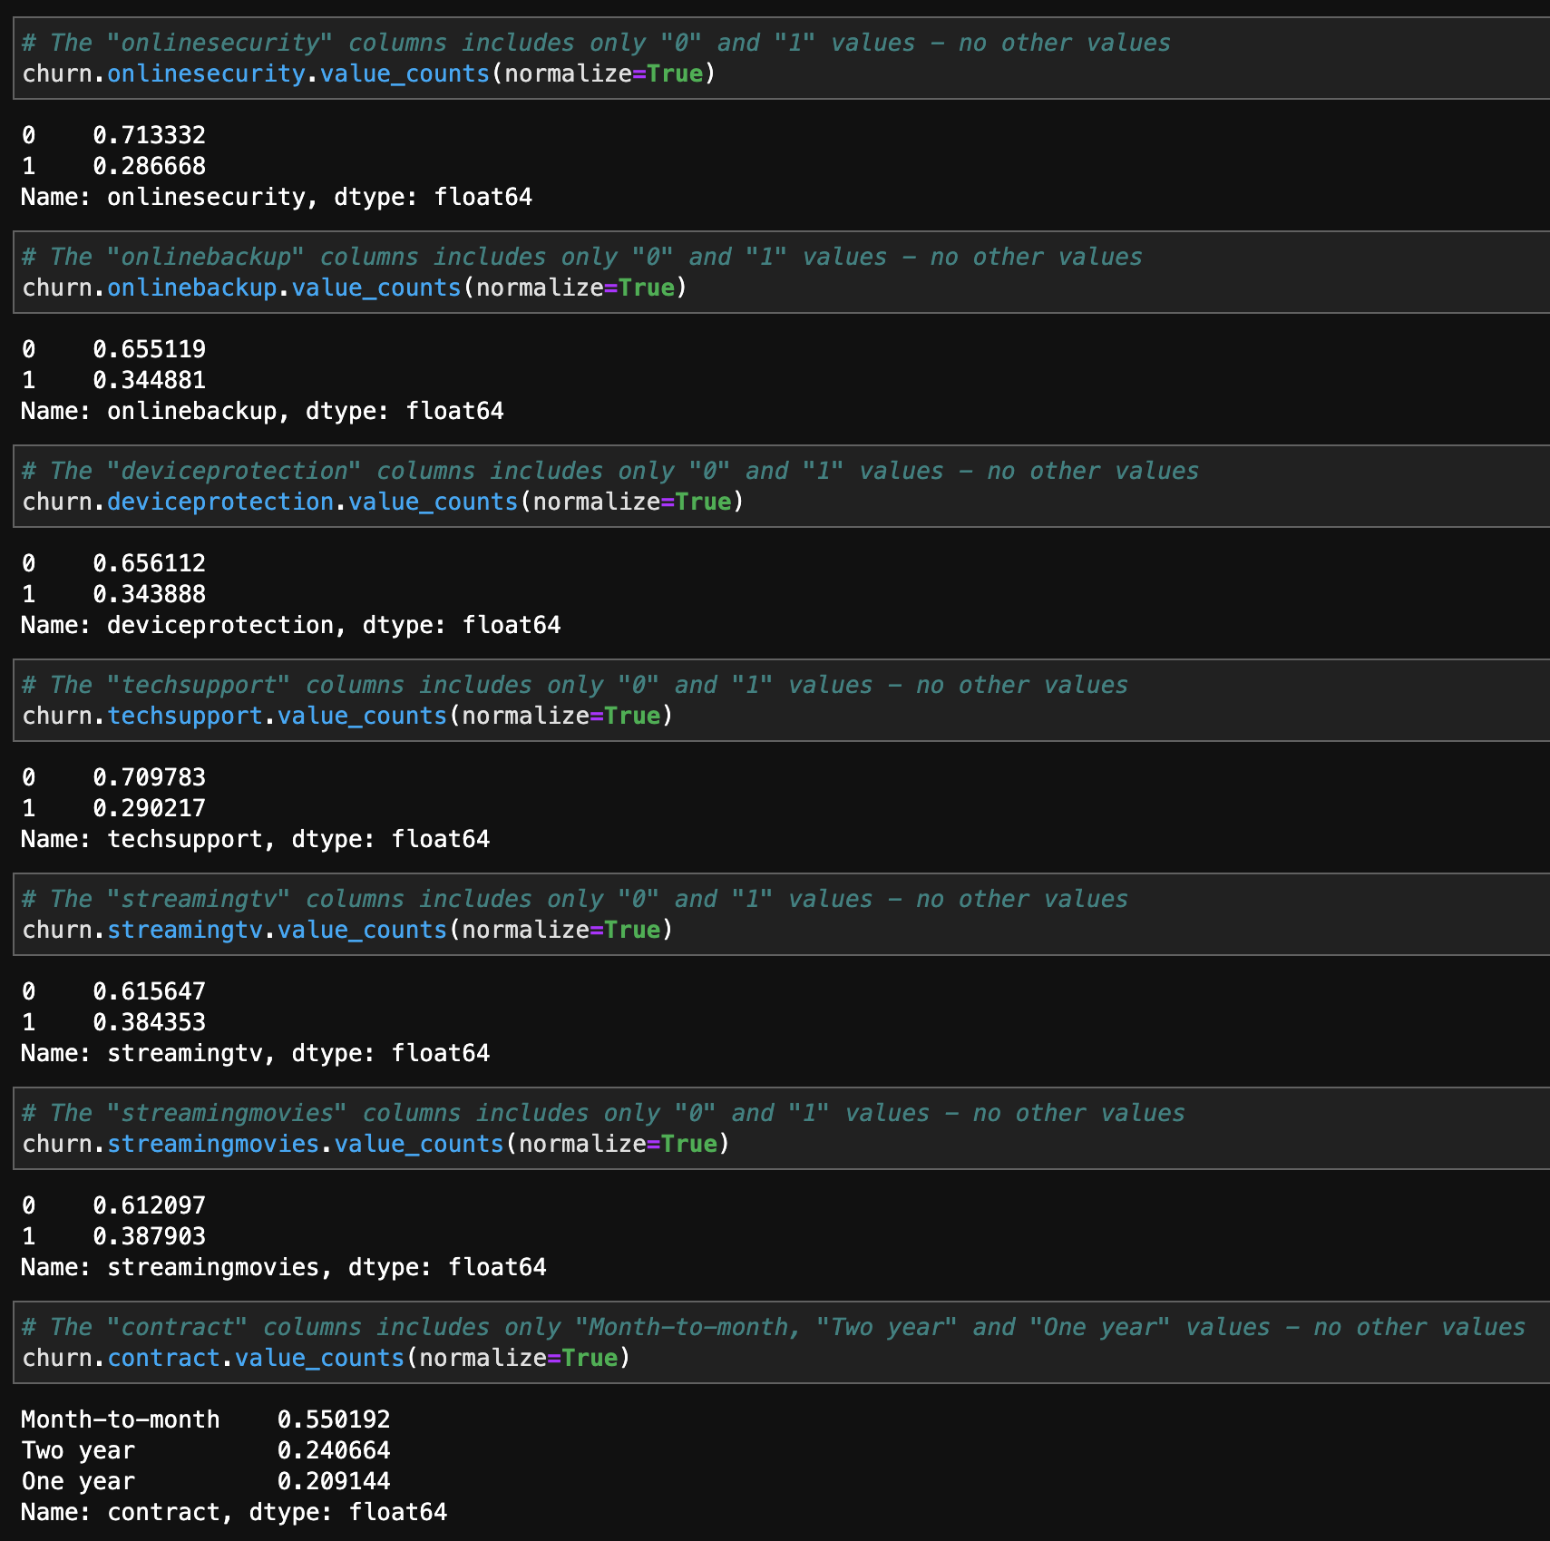
Labels distribution

Slide 8
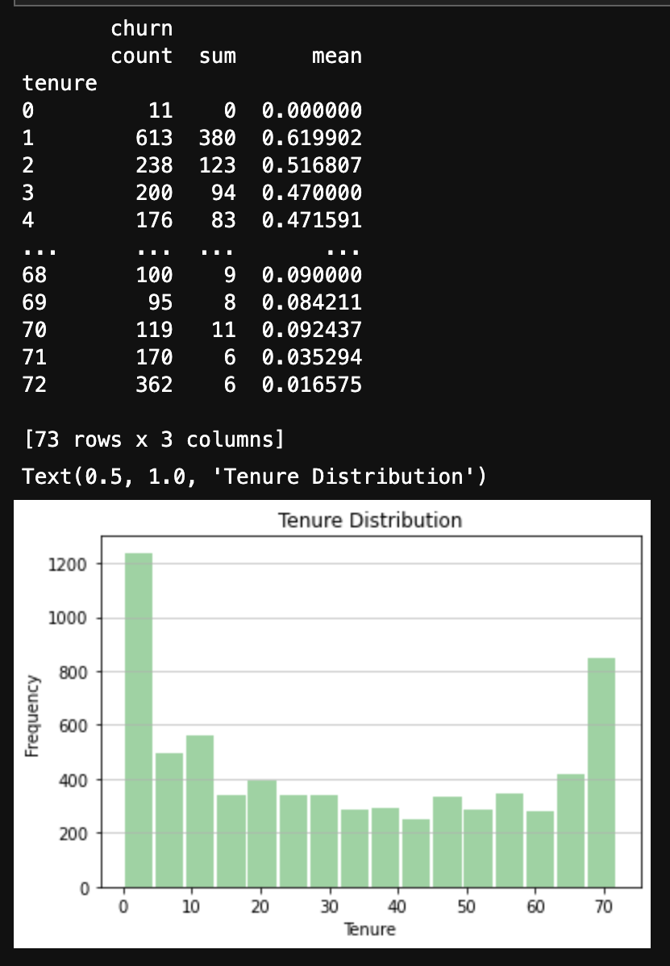
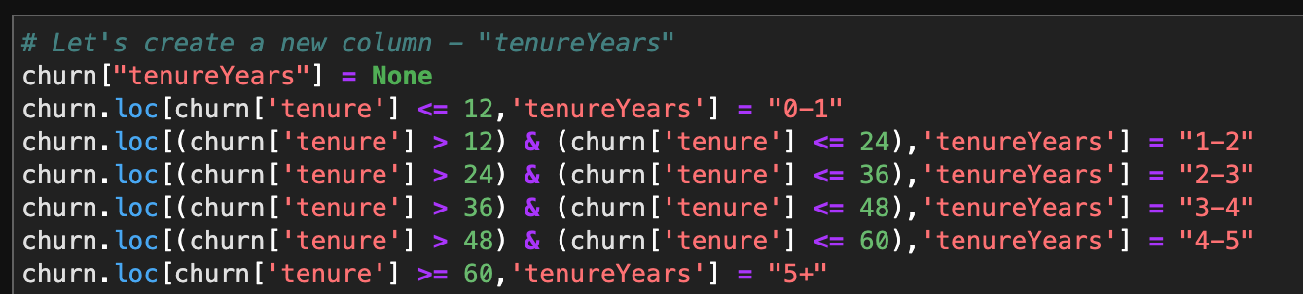
Labels distribution
The “tenure” column represents how many months a customer is with the company. It has 73 different values. We will create a new column called “tenureYears” that will group together customers by tenure years instead of tenure months

Slide 9
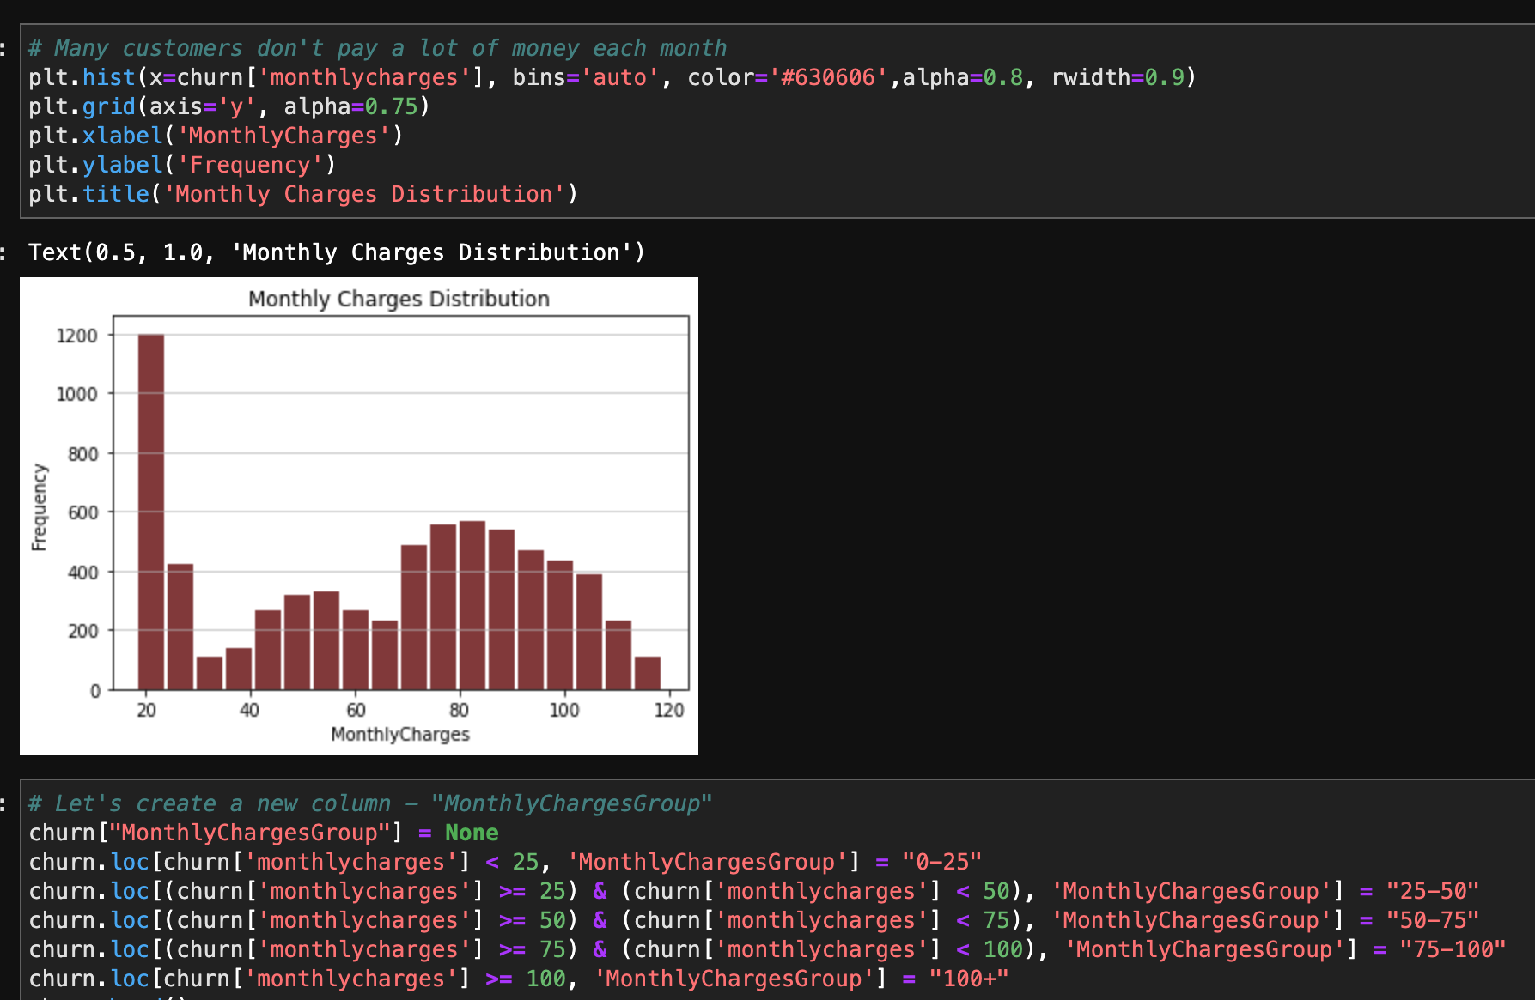
Labels distribution
The “Monthly charges” column also has many different values. We will group the different values in a new column called “Monthly charges group”

Slide 10
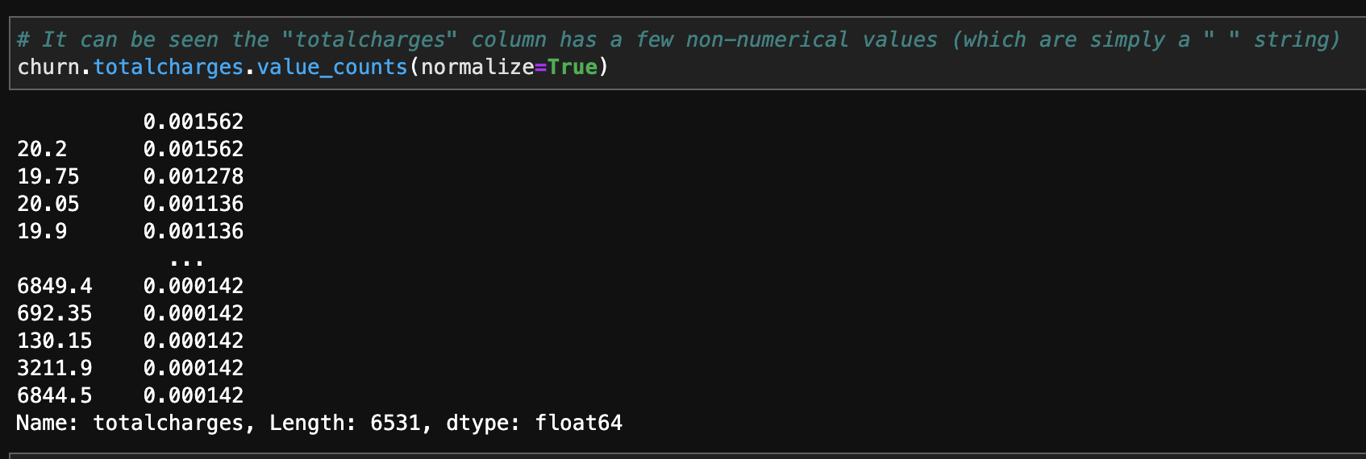
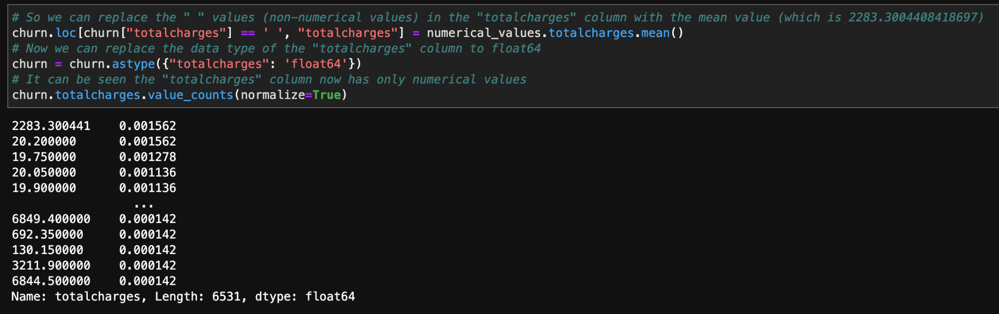
Missing values
At first sight it looked there were no missing values, but after performing value_counts() on all columns we found that the “Total charges” column has several rows that have an empty string value, which was not recognized by calling is_null(). We will replace these values with the mean value of all other values in this column

Slide 11
Data engineering
No features were removed but the “customerID” column isn’t considered as a feature
The following features were converted from “Yes”/”No” values to 1/0 values and the data type in them was changed from “string” to “int64”: “Partner”, “Dependents”, “Phone service”, “Paperless billing” and “churn”
For the following features that had “Yes”/”No”/”No phone service”/”No internet service”, “Yes” was replaced by 1 and ”No”/”No phone service”/”No internet service” were replaced by 0 since not having internet or phone service means that the customer also didn’t have the feature: "Multiple lines", "Online security", "Online backup", "Device protection", "Tech support", "Streaming TV", "Streaming movies"

Slide 12
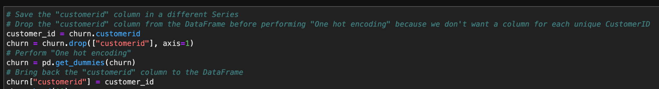
One hot encoding
The following features have categorical values which is not “Yes”/”No”, so we performed “one hot encoding” on them : “Gender”, “Internet service”, “Contract”, “Payment method”, “Tenure years”, “Monthly charges group”

Slide 13
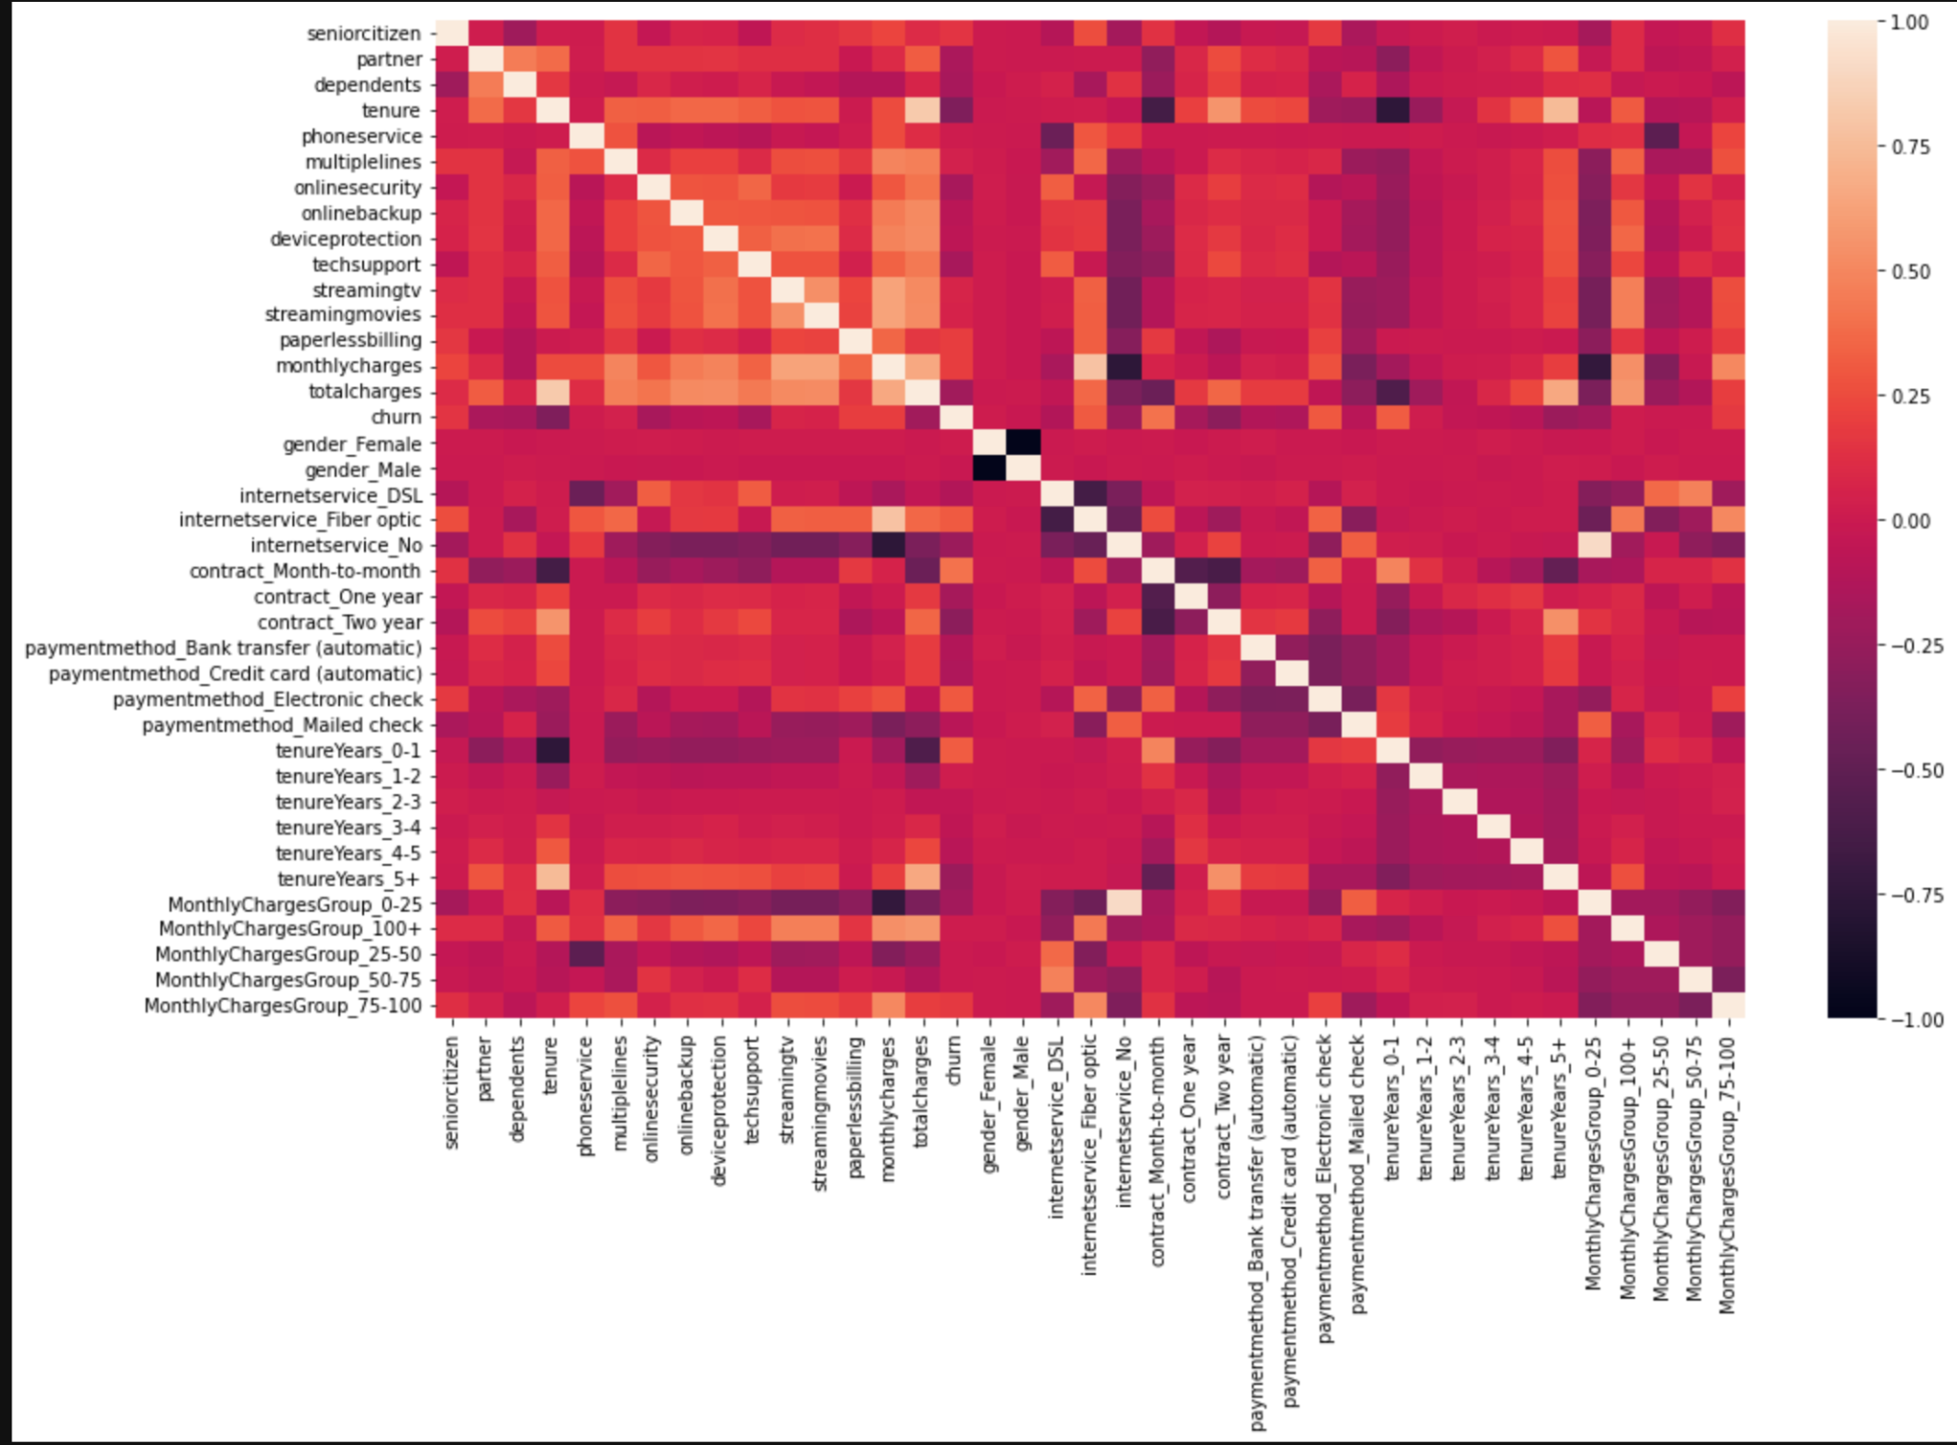
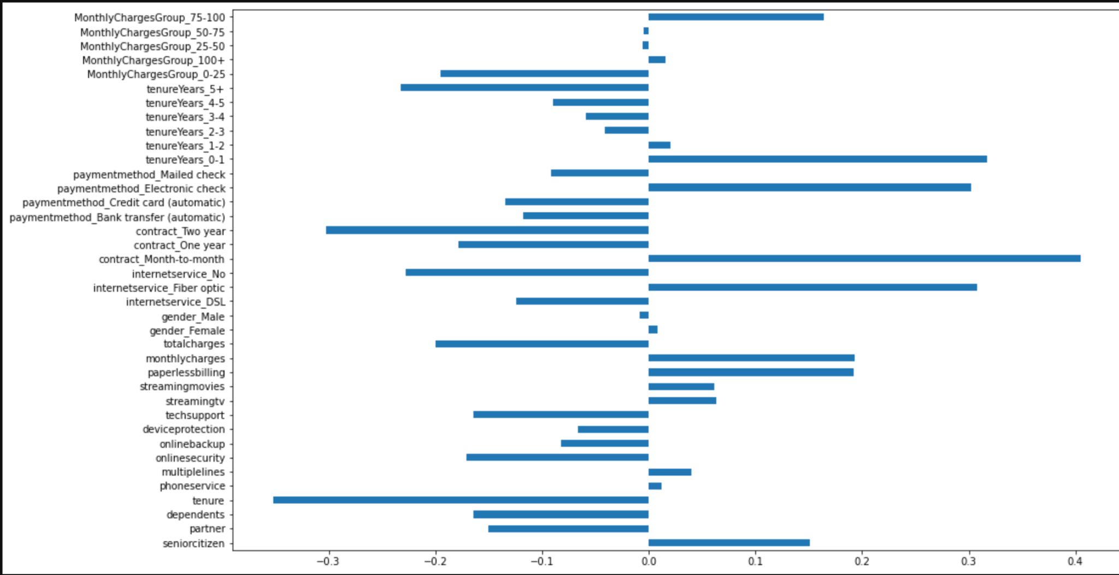
Finding correlations

Slide 14
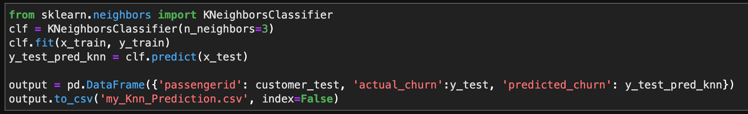
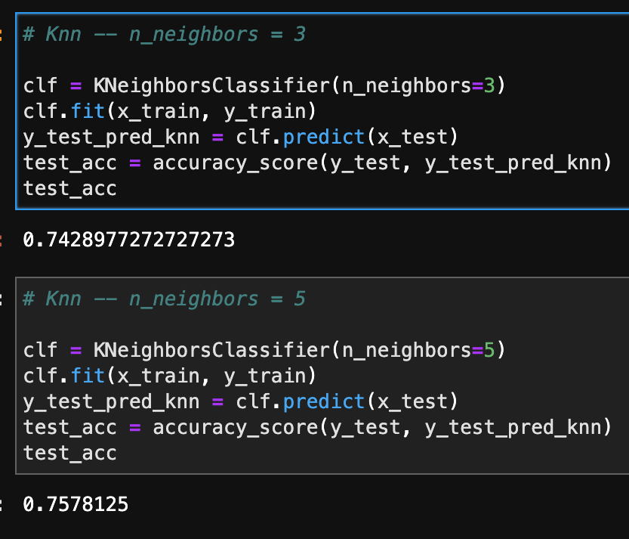
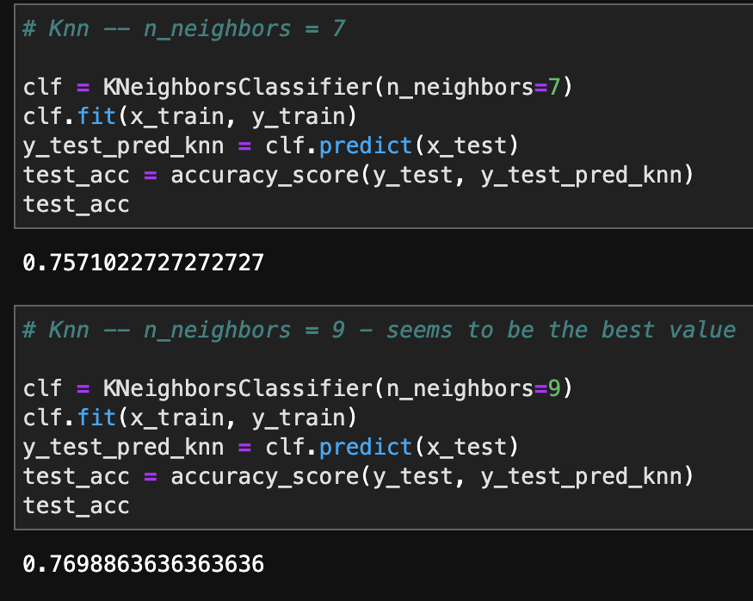
Machine learning algorithms -
K nearest neighbors - n_neighbors = 9 was the best result - accuracy score 0.769

Slide 15
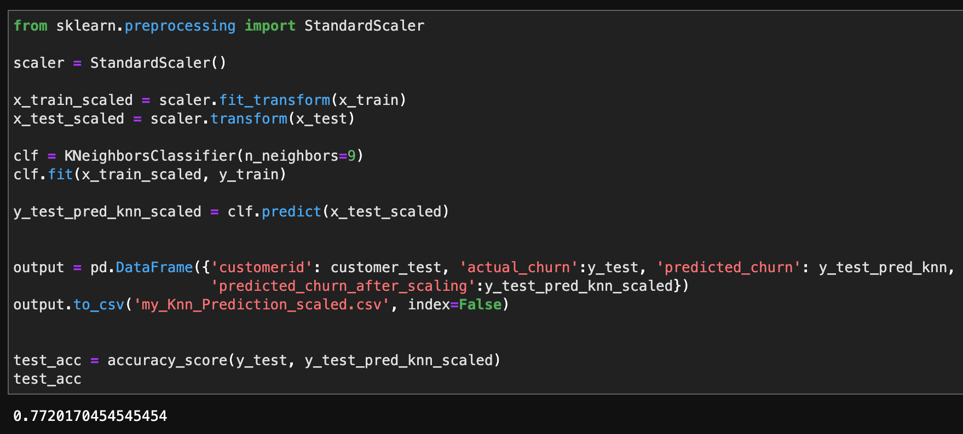
Machine learning algorithms -
K nearest neighbors - n_neighbors = 9
After scaling it was improved to 0.772

Slide 16
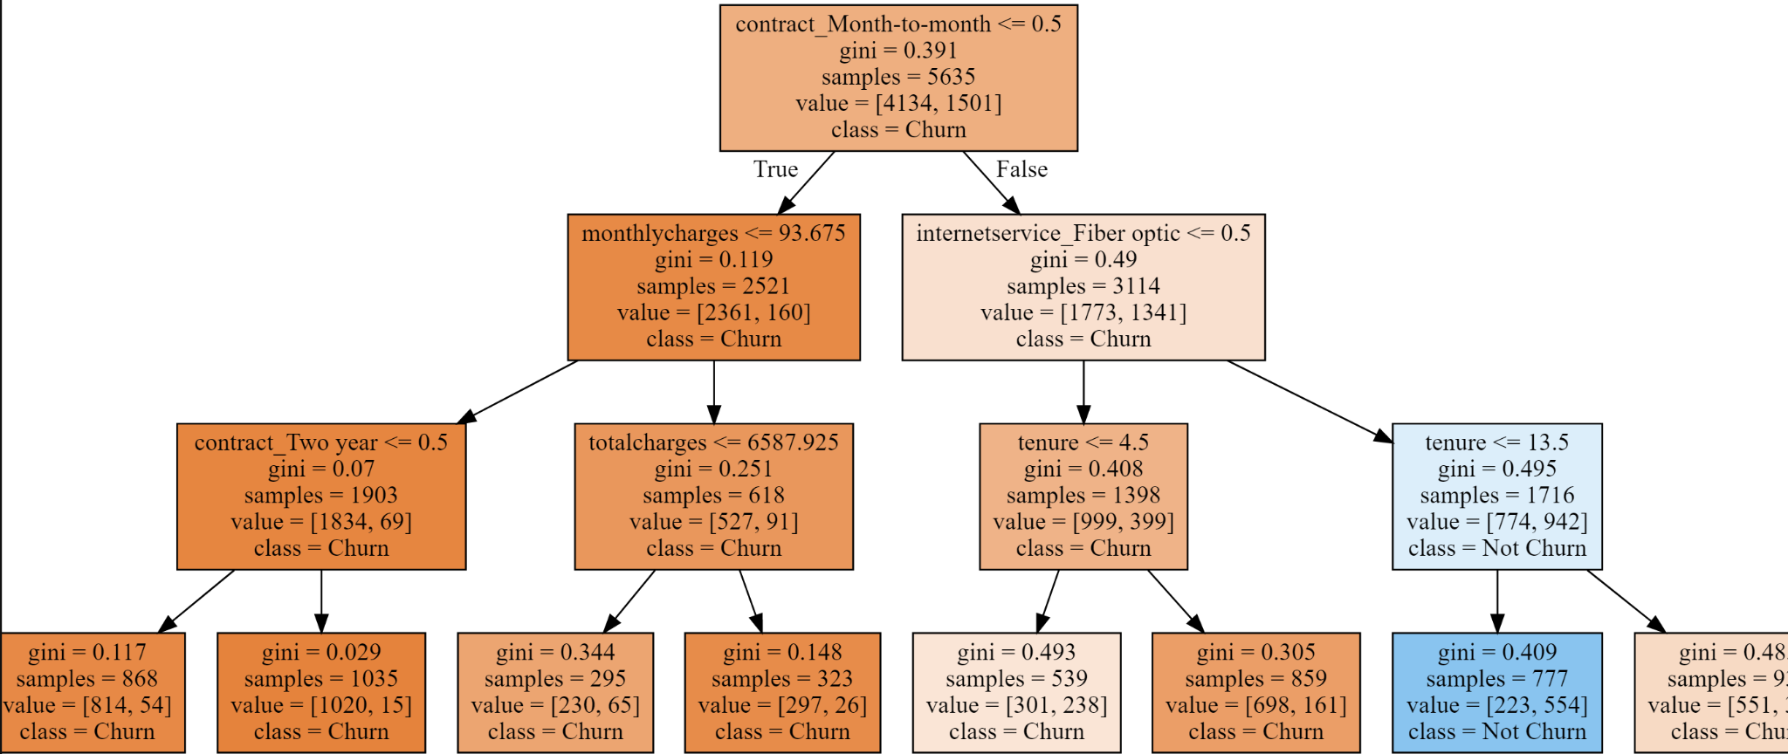
Machine learning algorithms -
Decision tree - max_depth = 3

Slide 17
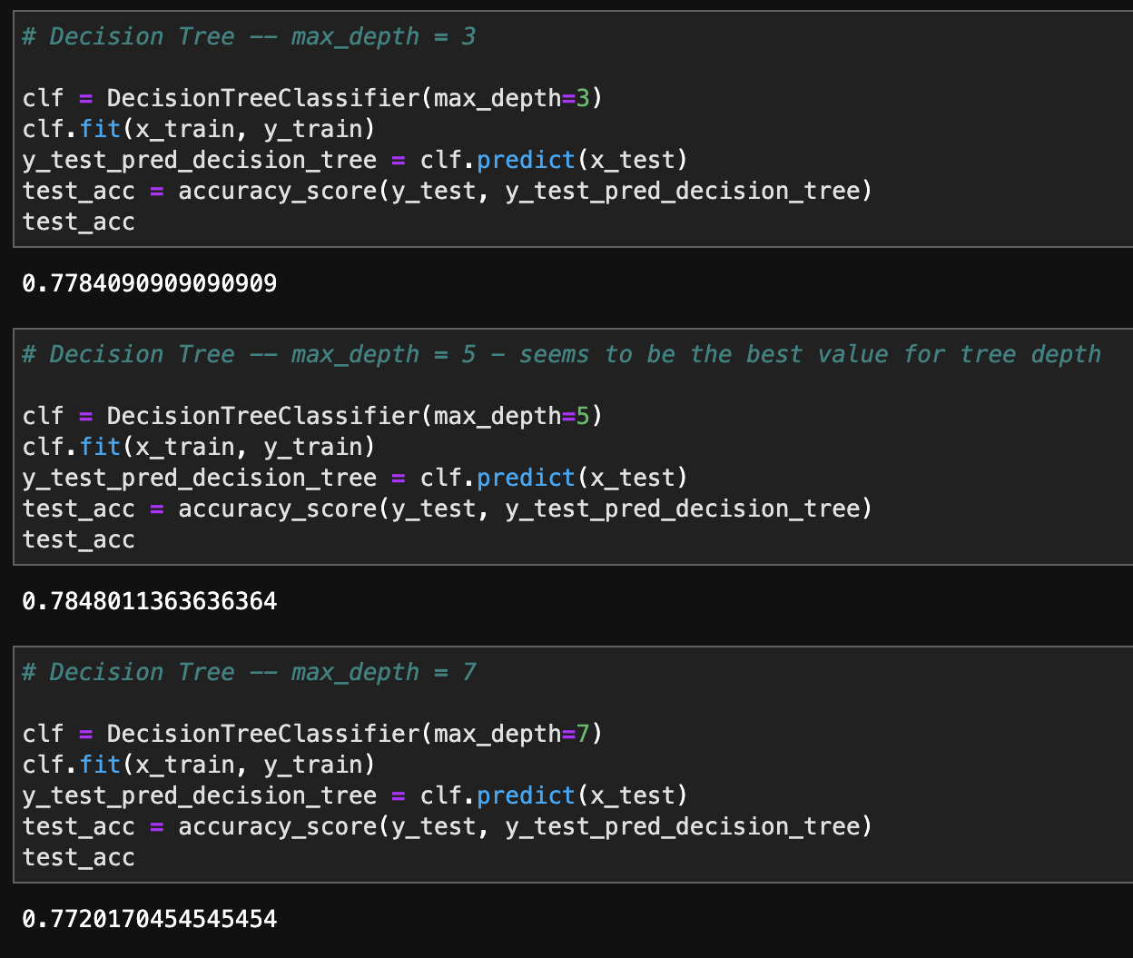
Machine learning algorithms -
Decision tree - max_depth = 5 was the best result - accuracy score 0.784

Slide 18
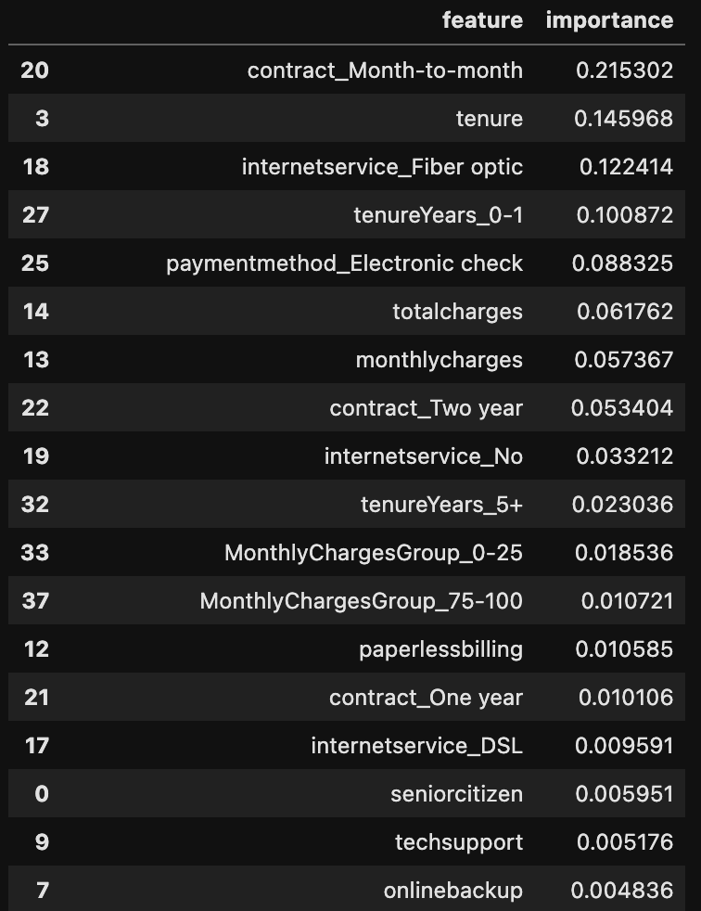
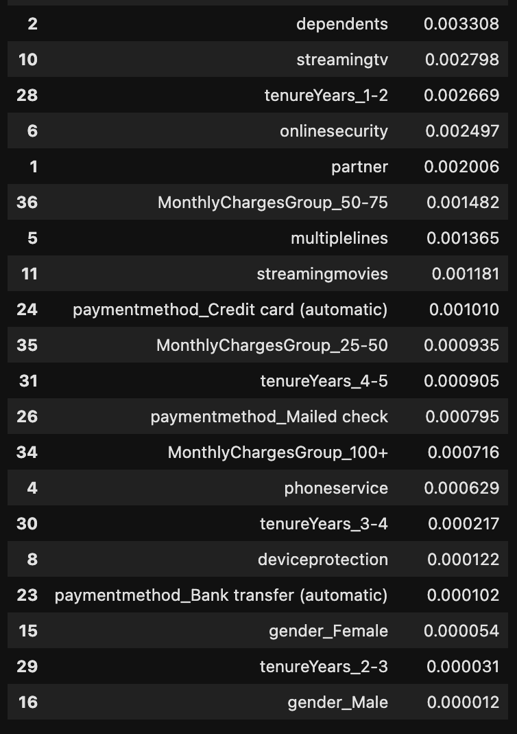
Machine learning algorithms -
Random forest - feature importance

Slide 19
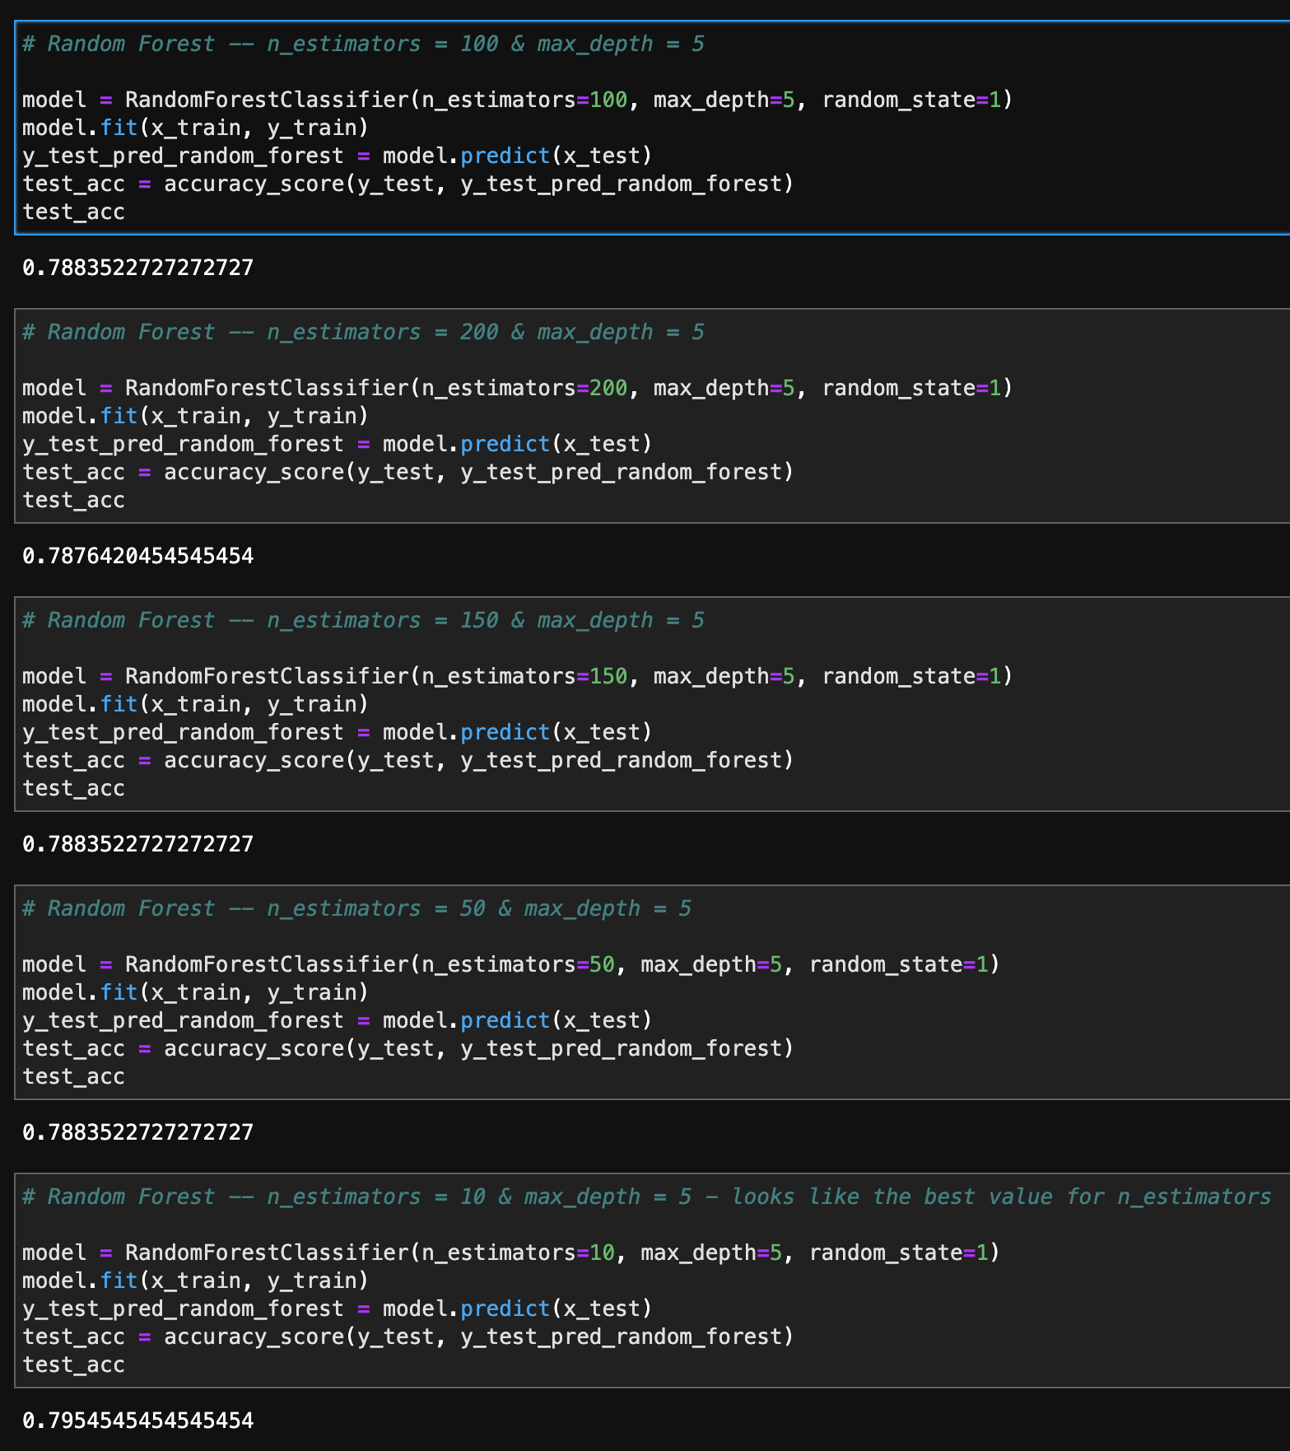
Machine learning algorithms -
Random forest - n_estimators = 10 was the best result for max_depth = 5 - accuracy score 0.795

Slide 20
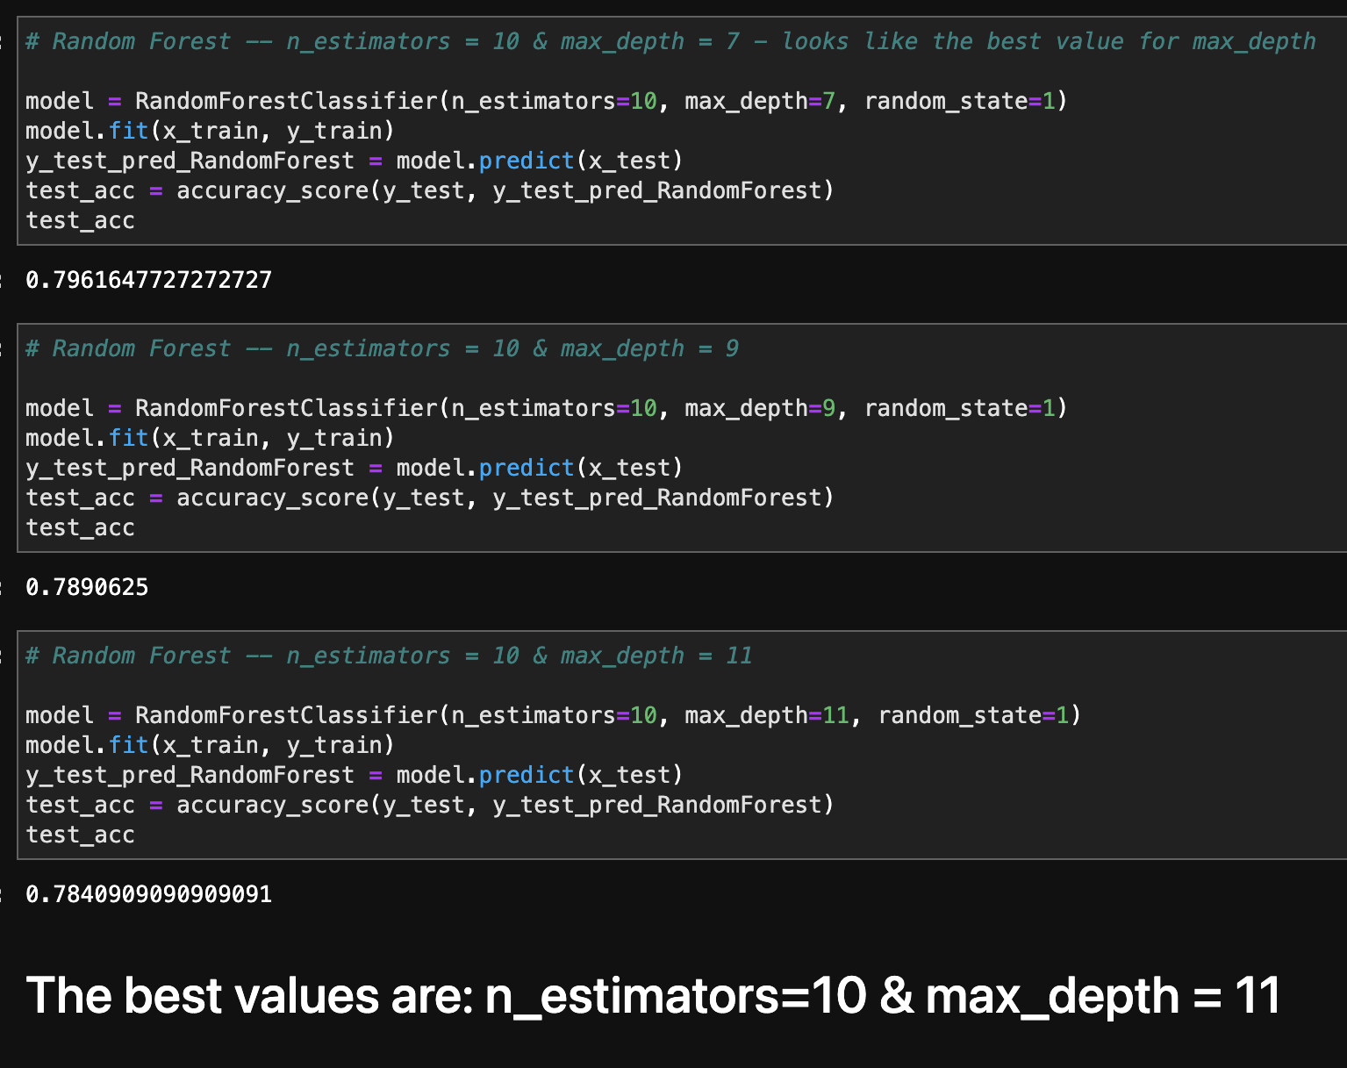
Machine learning algorithms -
Random forest - n_estimators = 10 was the best result for max_depth = 11

